Slide 1




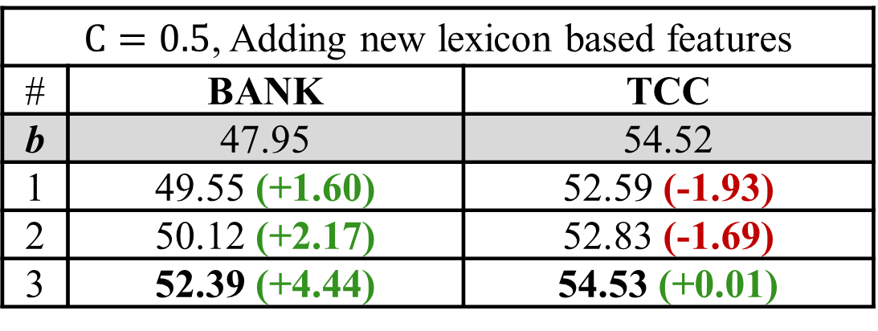

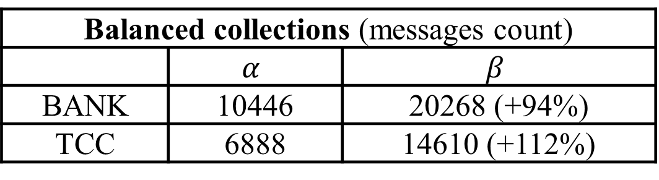
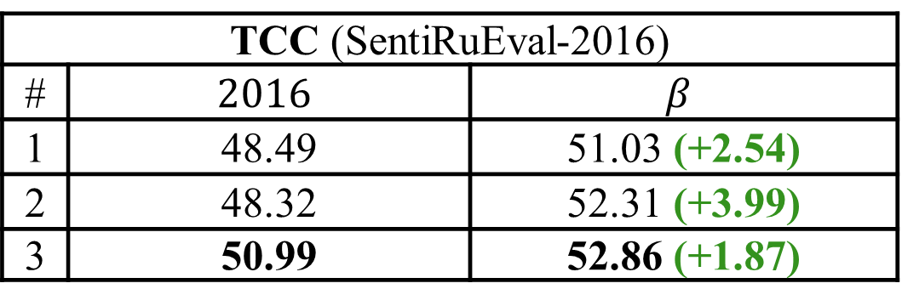
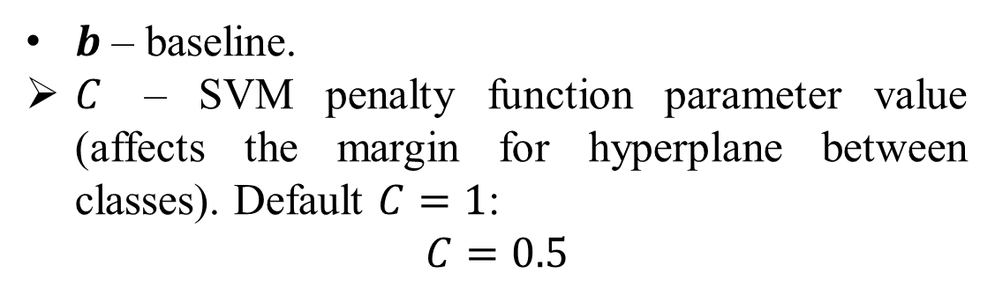
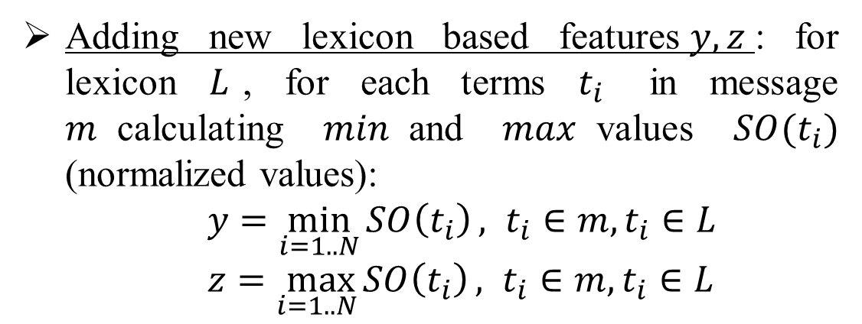


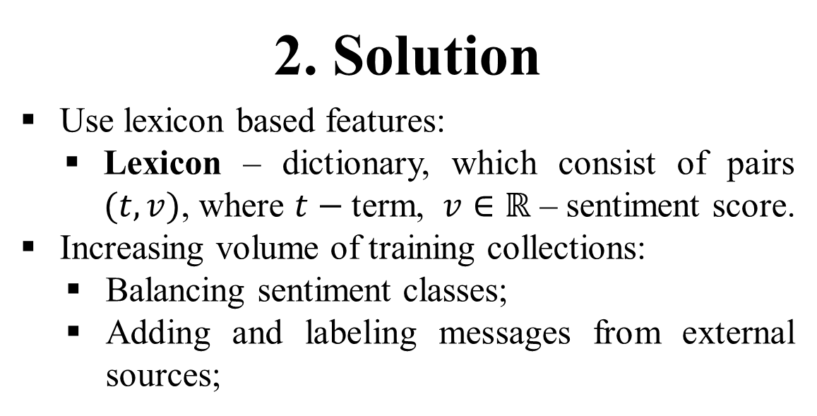
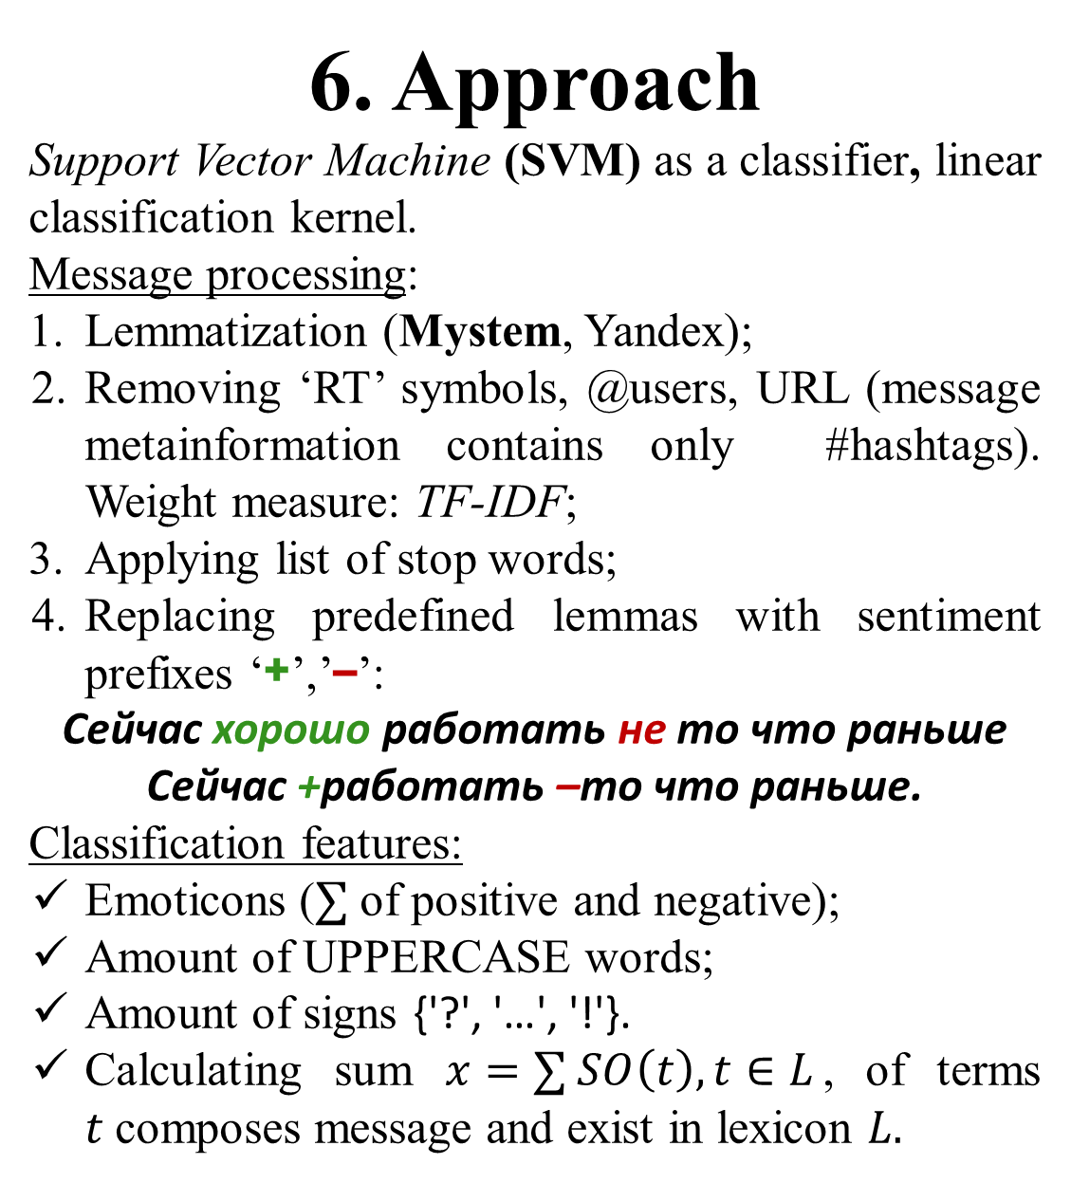

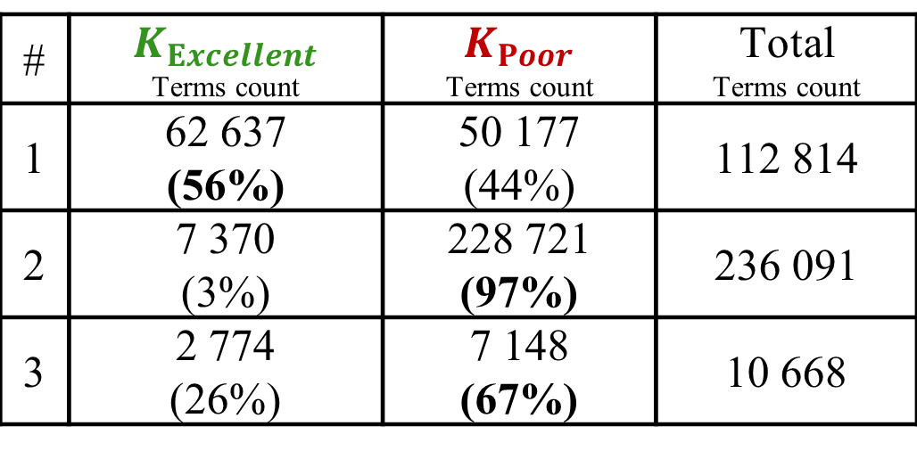
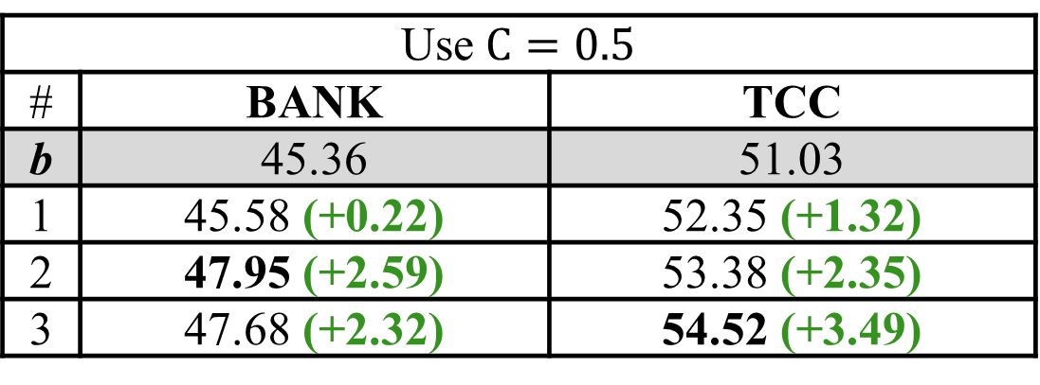
USE OF LEXICONS TO IMPROVE QUALITY OF SENTIMENT CLASSIFICATION
Rusnachenko N.L. Bauman Moscow State University (BMSTU), Moscow
kolyarus@yandex.ru
1. Problem
Building Machine Learning based model for Twitter messages sentiment classification task. (SentiRuEval competition)
Sentiment class defines for whole message, and shows relationship between message and company mentioned in it.
For each domain this problem resolves separately:
BANK – bank companies;
TCC – telecommunication companies.
Each message could be labeled with one of the following scores: {1, 0, -1}
5. Lexicons
Messages of Yu. Rubtsova short message corpus;
Twitter messages through the January, 2016;
Sentiment vocabulary RuSentiLex.
8. Results
Features settings:
№1– only Russian terms and hashtags;
№2 – №1 + using sentiment prefixes (‘+’, ‘-’), all features (using lexicons only #1 and #2);
№3 – №2 + using lexicon #3.
Quality measure: $F_{1}macro_{\left(neg, pos\right)}$
# | $K_{Excellent}$ Terms count | $K_{Poor}$ Terms count | Total Terms count
1 | 62 637 (56%) | 50 177 (44%) | 112 814
2 | 7 370 (3%) | 228 721 (97%) | 236 091
3 | 2 774 (26%) | 7 148 (67%) | 10 668
BANK (SentiRuEval-2016)
# | $$α$$ | $$β$$
1 | 38.40 | 45.36 (+6.96)
2 | 38.49 | 46.72 (+8.23)
3 | 38.62 | 46.83 (+8.21)
2. Solution
Use lexicon based features:
Lexicon – dictionary, which consist of pairs $(t, v)$, where $t−$ term, $v∈ℝ$ – sentiment score.
Increasing volume of training collections:
Balancing sentiment classes;
Adding and labeling messages from external sources;
6. Approach
Support Vector Machine (SVM) as a classifier, linear classification kernel.
Message processing:
Lemmatization (Mystem, Yandex);
Removing ‘RT’ symbols, @users, URL (message metainformation contains only #hashtags). Weight measure: TF-IDF;
Applying list of stop words;
Replacing predefined lemmas with sentiment prefixes ‘+’,’–’:
Сейчас хорошо работать не то что раньше
Сейчас +работать –то что раньше.
Classification features:
Emoticons ($∑$ of positive and negative);
Amount of UPPERCASE words;
Amount of signs {'?', '…', '!'}.
Calculating sum $x=∑ SO\left(t\right), t∈L$, of terms $t$composes message and exist in lexicon $L.$
TCC (SentiRuEval-2016)
# | $$2016$$ | $$β$$
1 | 48.49 | 51.03 (+2.54)
2 | 48.32 | 52.31 (+3.99)
3 | 50.99 | 52.86 (+1.87)
Using $β$ as a train collection improves classification quality (right column).
3. Used articles
Building lexicons (the main idea):
PMI – Pointwise mutual information;
SO – Semantic orientation
(Turney P., 2002)
On the Automatic Learning of Sentiment Lexicons, Human Language Technologies (Severyn A., Moshitti A., 2015)
NRC-Canada: Building the State-of-the-Art in Sentiment Analysis of Tweets (Saif. M. Kiritchenko S., Xiaodan Z., 2015)
9. Improvements
$b$ – baseline.
$C$ – SVM penalty function parameter value (affects the margin for hyperplane between classes). Default $C=1$:
$$C=0.5$$
Use $С=0.5$
# | BANK | TCC
b | 45.36 | 51.03
1 | 45.58 (+0.22) | 52.35 (+1.32)
2 | 47.95 (+2.59) | 53.38 (+2.35)
3 | 47.68 (+2.32) | 54.52 (+3.49)
7. Training Collections
Imbalanced collections:
Provided by SentiRuEval organizers:
4. Building Lexicons
Based on pointwise mutual information of terms$t_{1}, t_{2}$:
$$PMI\left(t_{1}, t_{2}\right)=\log_{2}{\frac{P(t_{1}∧t_{2})}{P\left(t_{1}\right)⋅P(t_{2})} }$$
Introducing marker as a second parameter of $PMI$ function. Possible marker values:
Excellent;
Poor.
Semantic orientation is a function:
$$SO\left(t\right)=PMI\left(t, \text{Excellent}\right)−PMI(t, \text{Poor})$$
$sgn(SO\left(t\right))$ – determines the marker type of term $t$;
$\left|SO\left(t\right)\right|$ – degree of belonging.
Building lexicon from messages of collection $K=K_{Excellent}∪K_{Poor}$:
$$S:\left\{ 〈t, SO\left(t\right)〉 \right| t∈K_{Excellent}∪K_{Poor}\}$$
$K_{Excellent}$ -- messages labeled Excellent.
$K_{Poor}$ -- messages labeled Poor.
Making sentiment collections $K$ from scratch (automatic labeling):
Receive messages via Streaming Twitter API, and composing collection $K$.
Split collection messages $K$ with $K_{Excellent}$ and $K_{Poor}$ by means of:
Message emoticons (:-), :-(, xD, …);
2015 (messages count)
 | ☺ | 😐 | ☹ | Total
BANK | 356 (7%) | 3 482 (71%) | 1 077 (21%) | 4 915
TCC | 956 (19%) | 2 269 (47%) | 1 634 (34%) | 4 859
Adding new lexicon based features$y, z$: for lexicon $L$, for each terms $t_{i}$ in message $m$calculating $min$and $max$values $SO(t_{i})$ (normalized values):
$y=\min_{i=1..N}{SO\left(t_{i}\right)}, t_{i}∈m, t_{i}∈L$
$z=\max_{i=1..N}{SO\left(t_{i}\right)}, t_{i}∈m, t_{i}∈L$
2016
BANK | 1 354 (15%) | 4 870 (55.4%) | 2 550 (29%) | 8 783
TCC | 704 (7%) | 6 756 (74.22%) | 1 741 (19%) | 9 102
$С=0.5$, Adding new lexicon based features
# | BANK | TCC
b | 47.95 | 54.52
1 | 49.55 (+1.60) | 52.59 (-1.93)
2 | 50.12 (+2.17) | 52.83 (-1.69)
3 | 52.39 (+4.44) | 54.53 (+0.01)
Balanced collections:
Balancing: filtering messages${m=\left\{t_{i}\right\}}_{i=1}^{N}$ from Yu. Rubtsova corpus (by means of Lexicon, based on the same corpus) by formula:
$$\max_{i=1..N}{|SO\left(t_{i}\right)|}>Bound$$
$Bound$ – bounding value, $t_{i}$– message terms.
$α$ – balanced 2015 train collection.
$β$ – united collections of 2015 and 2016 years, and then balanced.
Conclusion
Classification quality stable improves after using balanced collection and lexicon based features.
Quality improvement | BANK | TCC
Total | +13.99 | +6.03
Balanced collections (messages count)
 | $$α$$ | $$β$$
BANK | 10446 | 20268 (+94%)
TCC | 6888 | 14610 (+112%)
Future possible improvements:
Using hierarchy classification model;
Calculating lexicon based features, depending on TF-IDF terms weights.

